Slide 1
Shell Bootcamp 2024 3 Reflections for Week #<>
Arsh Arif Afrah
Date : 6-Sep-2024

Slide 2

About Me
Dream big, act bigger.

Slide 3

My learnings from this week!

Slide 4
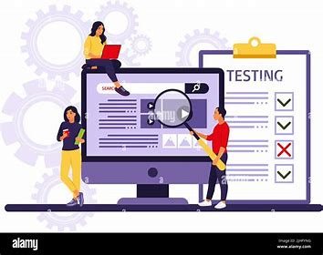
Learning 1 | My takeaways
Testing
Understanding the various types of testing is crucial for creating reliable and stable software.
Key Takeaway
Each stage of the development life cycle necessitates different types of testing.
Application in the Energy Sector
In the energy sector, ensuring that every application is stable and safe for daily use is vital to prevent accidents, and comprehensive testing plays a key role in achieving this.

Slide 5
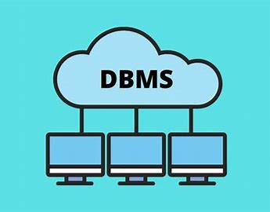
Learning 2 | My takeaways
Database Management System
Key learning A DBMS is crucial for efficiently storing, managing, and securing large datasets. Key concepts include relational databases, SQL, and transaction management, ensuring data integrity and consistency.
Key takeaway DBMS enhances decision-making, real-time data analysis, and workflow efficiency by securely managing large-scale data and reducing redundancy.
Implementation in the Energy sector DBMS helps manage vast energy-related data from sensors and smart grids, optimizing energy use, predicting maintenance, and supporting sustainability efforts while ensuring regulatory compliance and security.

Slide 6

Learning 3 | My takeaways
Key Learning
GitHub Actions streamlines workflows by automating the processes of building, testing, and deploying code directly from repositories, thereby boosting efficiency and minimizing the need for manual intervention.
Key Takeaway
Automation significantly enhances productivity and consistency in software development. By setting up workflows that trigger tests or deployments based on specific events, projects remain current, thoroughly tested, and deployed with minimal errors.
Energy Sector Application
In the energy sector, GitHub Actions can ensure that software deployment is both reliable and efficient, contributing to safer and more stable operations.

Slide 7

Relevance of learnings for my organization

Slide 8

Learning 1 | Relevance for Shell
Shell follows the concept of Test-Driven Development (TDD). In this approach, every piece of software developed at Shell is unit tested, ensuring that each piece of logic works as intended.
Safety is a top priority at Shell, especially since the software developed is deployed in the energy sector. It is crucial to prevent any failures that could endanger the people relying on the software to operate safely.

Slide 9
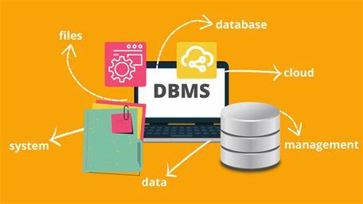
Learning 2 | Relevance for Shell
How Shell Implements This Learning
Shell leverages Database Management Systems (DBMS) to handle extensive data from its global operations. This optimizes processes, enables real-time monitoring, and ensures regulatory compliance, thereby enhancing decision-making and sustainability efforts.
How Shell Benefits from This Learning
DBMS improves Shell’s data management capabilities, allowing for better resource allocation, predictive maintenance, and cost reduction. It also enhances data security, supports innovation, and sustainability, and helps maintain a competitive edge.

Slide 10

Learning 3 | Relevance for Shell
Shell and Automation
Shell probably employs GitHub Actions to automate its software workflows, ensuring that updates are swiftly and reliably tested before deployment. This practice aligns with Shell’s emphasis on innovation and efficiency, fostering reliable and advanced solutions. Automation enhances development speed, minimizes downtime, and frees up developer time, leading to cost savings, better resource utilization, and improved operational resilience.

Slide 11

Challenges in implementing learning

Slide 12
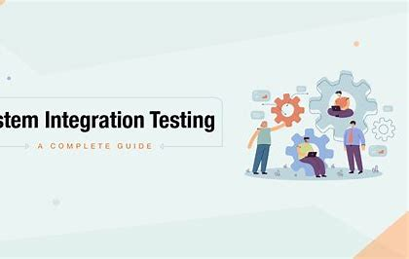
Challenge faced while implementing Learning 1
I am familiar with using JUnit for unit testing, but recently, I had the new experience of learning to use the Fitnesse tool. System testing and integration testing were new to me, requiring considerable effort and experimentation to understand how they function.

Slide 13
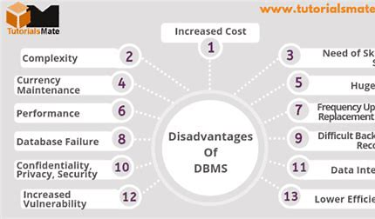
Challenge faced while implementing Learning 2
Integrating DBMS with existing systems while ensuring data consistency and efficient migration was a significant challenge. Additionally, managing large datasets and optimizing query performance for real-time analytics proved difficult.
Plan to Address
To tackle these issues, I plan to:
Enhance my DBMS knowledge.
Explore migration tools and indexing techniques.
Collaborate with colleagues.
Leverage Shell’s training resources for a smoother implementation.

Slide 14
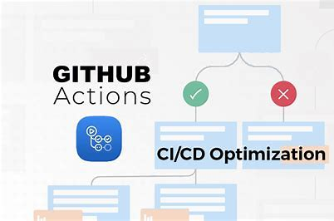
Challenge faced while implementing Learning 3
The main challenges I encountered were structuring workflows correctly in YAML, managing complex pipelines, and troubleshooting integration with third-party tools. Debugging failed workflows was also difficult due to limited logging and error visibility.
My Plan to Overcome These Challenges: To address these issues, I plan to: Study YAML and GitHub Actions documentation more thoroughly. Use reusable workflows for consistency. Implement better logging and monitoring for easier debugging. Seek advice from experienced colleagues or the GitHub community. Test smaller workflow components before full integration.

Slide 15

Action Plan

Slide 16
My Action Plan for this Week
Actions
Timeline
Status
Understand all the technical skills taught during the week.
Learn how to apply these technical skills in a work environment.
Implement all the acquired knowledge and skills throughout the week.
Implementation should be on the same day as the learning.
Keep learning through out the week.
Implemented the different learnings like Agile(Scrum, Kanban), DBMS concepts, Cloud and

Slide 17

Learning is also Fun!

Slide 18
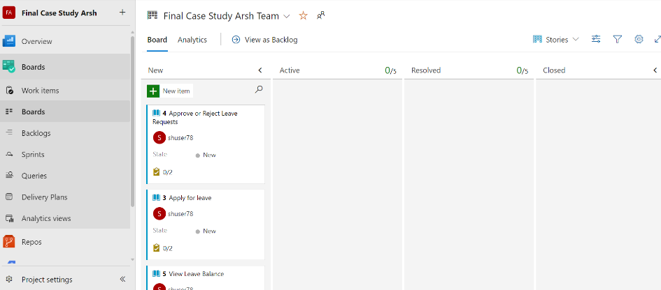
Learning is also Fun!
This week’s classes were very interactive and informative. All the lessons were in depth and backed by example along with practical implementation during the class it self.
We also had a scrum roleplay as a team to get us accustomed to the scrum framework.

Slide 19

Summary
Quick summary
Importance of topics of upcoming week
Connectivity of topics from current week

Slide 20
Thank You

